Slide 1

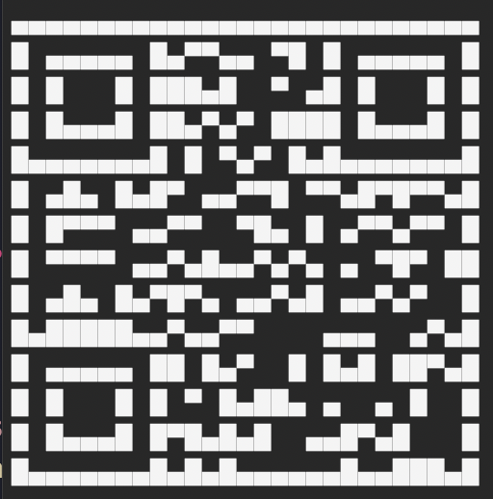

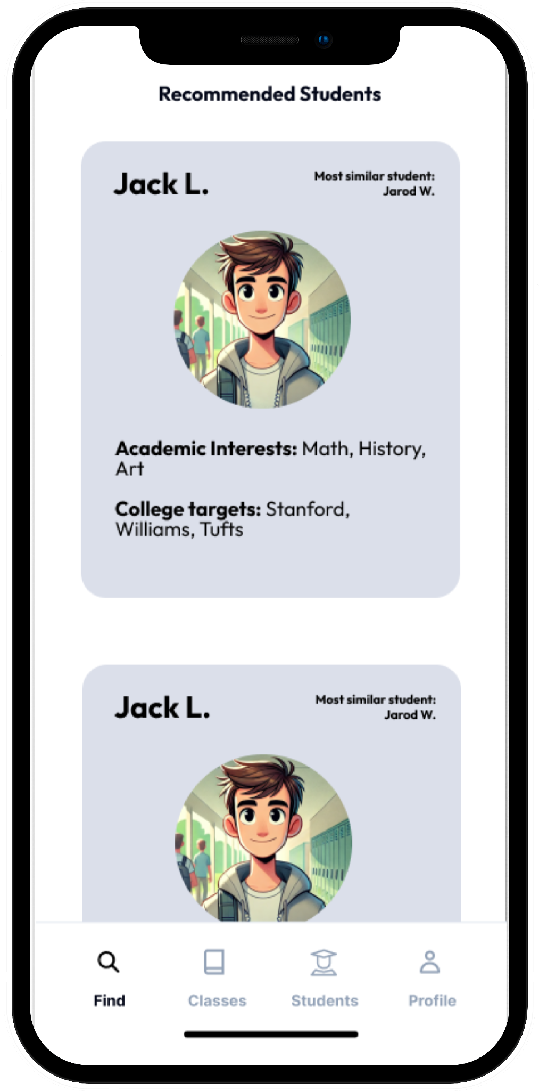
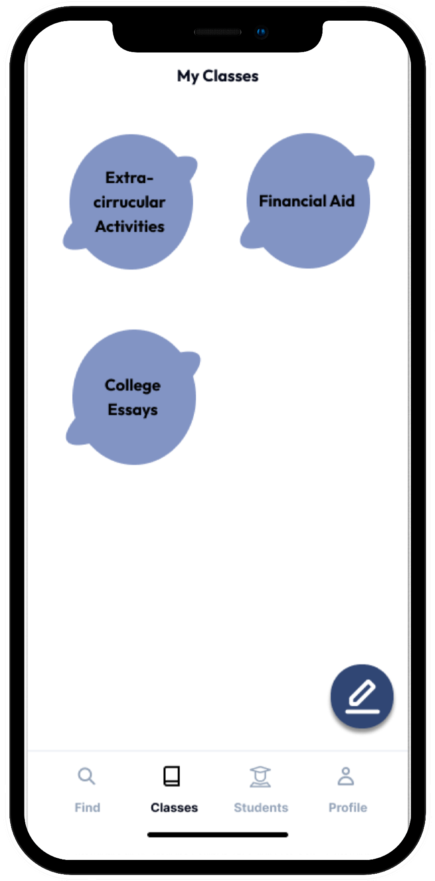
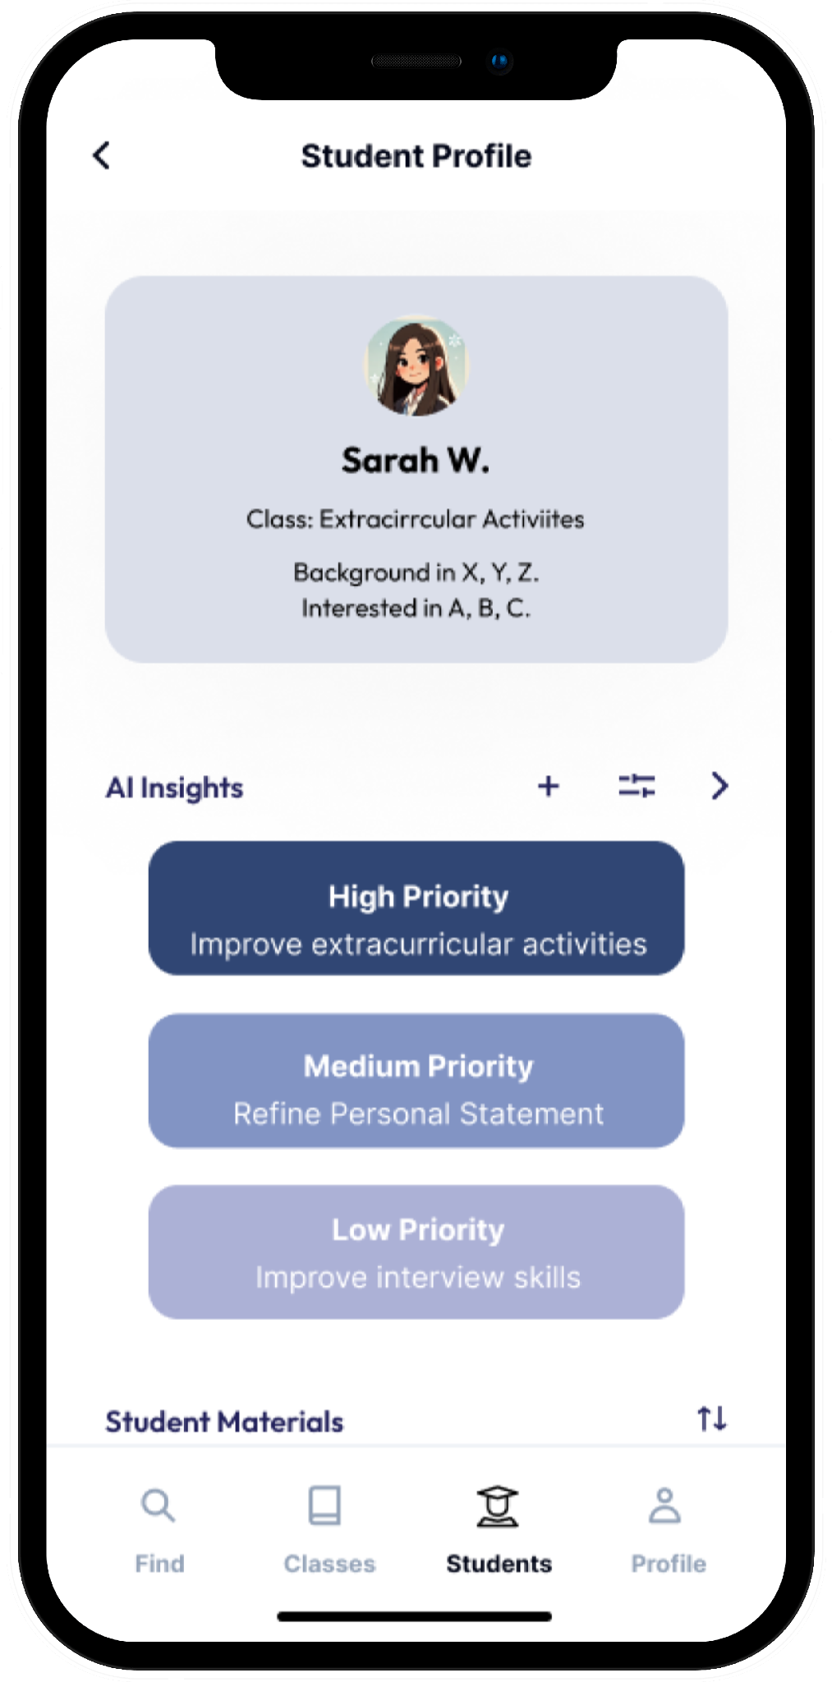
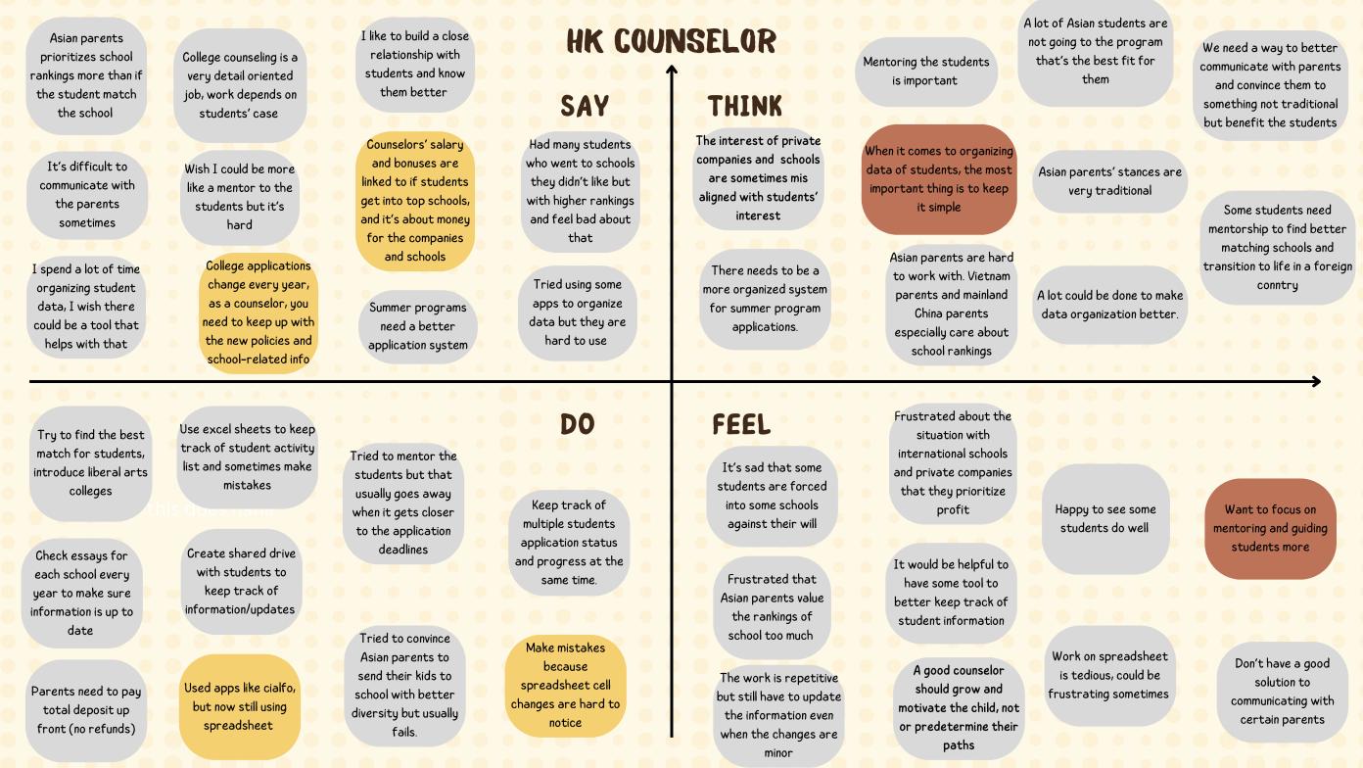
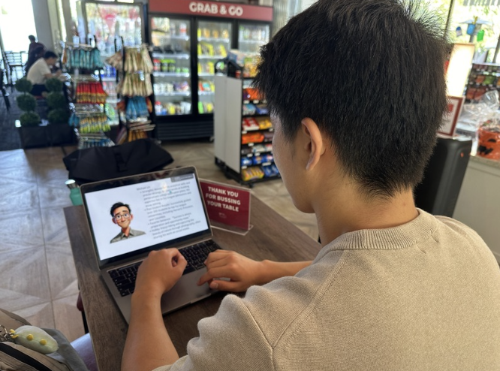
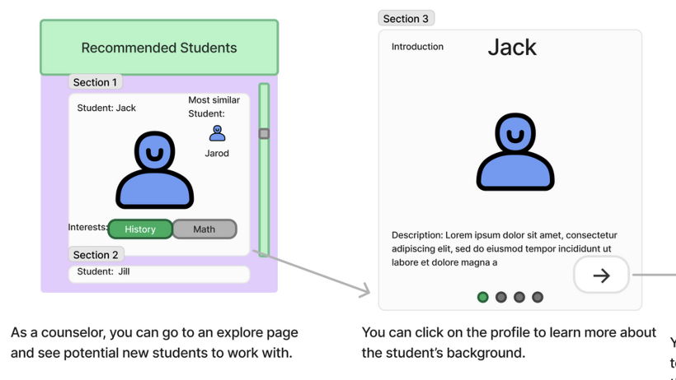
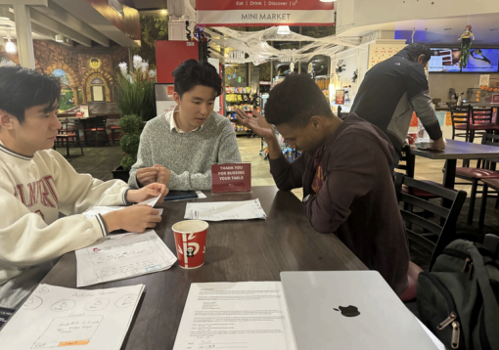
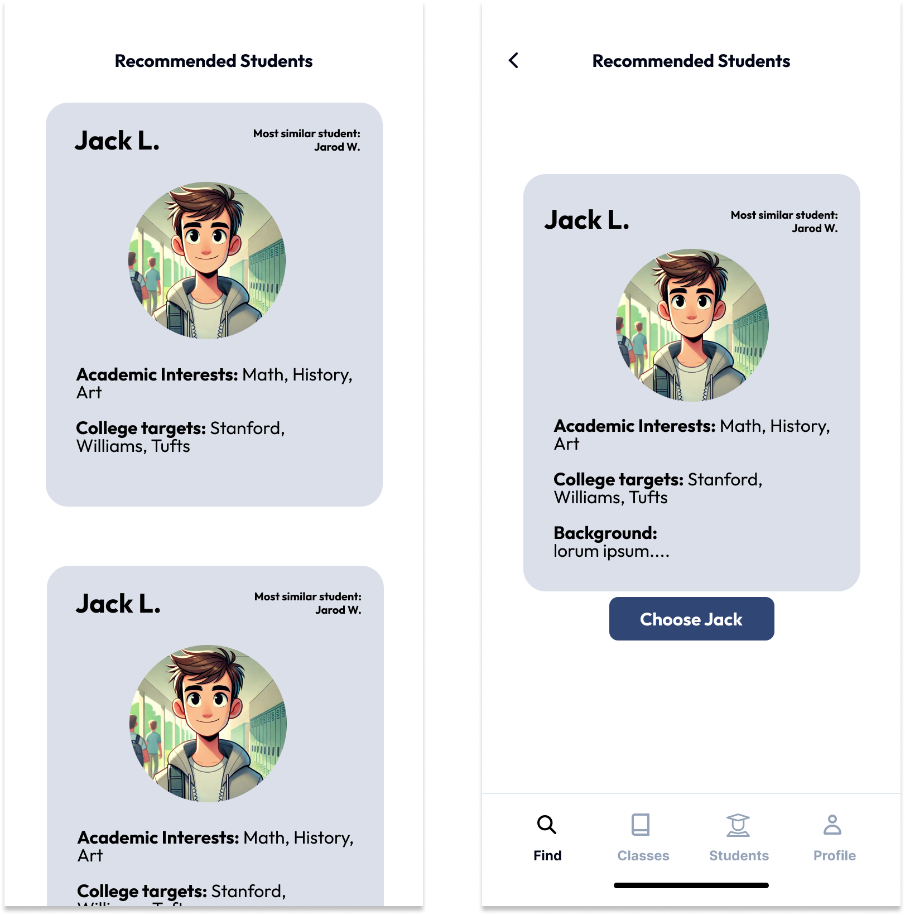
UniVerse
College mentorship with freedom and ease
Find students with similar interests
Group students into classes and teach
Get AI-powered insights on students
Problem
College counselors lack independence when choosing students they want to work with
Solution
Counselors can choose to work with students with interests and backgrounds that align with theirs
Design Process
Needfinding
Experience prototype
Low-fi
Usability testing
Med-fi
Designed and developed by Sally W., Zijian L., Steve D., and Eric F. | CS 147 Autumn 2024 https://web.stanford.edu/class/cs147/projects/Job-Accessibility-Career-Development/UniVerse/

